Slide 1


Slide 2

JEREMIAH 29:11
For I know the plans I have for you,” declares the Lord, “plans to prosper you and not to harm you, plans to give you hope and a future.

Slide 3
THE VERY BEST THAT GOD
HAS PLANNED FOR YOU
IS FOUND IN JESUS CHRIST

Slide 4
DANIEL 9: A CONVERSATION
WHAT DANIEL SAYS TO GOD
(V.1-19)

Slide 5
DANIEL 9: A CONVERSATION
WHAT DANIEL SAYS TO GOD
(V.1-19)
WHAT GOD SAYS TO DANIEL
(V.20-27)

Slide 6
DANIEL 9: A CONVERSATION
WHAT DANIEL SAYS TO GOD
(V.1-19)

Slide 7
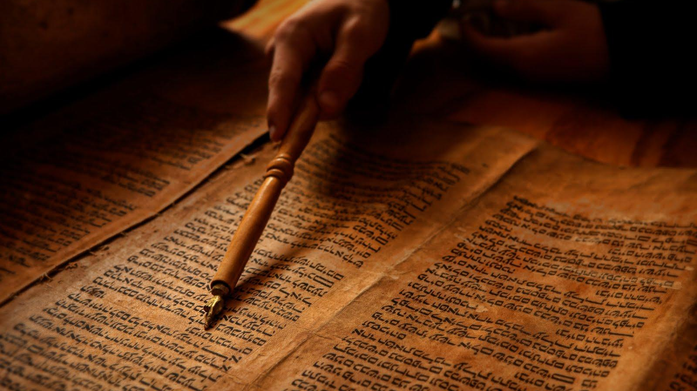
  This whole country will become a desolate wasteland, and these nations will serve the king of Babylon seventy years
  Jeremiah 25:11-12

Slide 8
  “When seventy years are completed for Babylon, I will come to you and fulfil my good promise to bring you back to this place. For I know the plans I have for you,” declares the Lord, “plans to prosper you and not to harm you, plans to give you hope and a future.”
  Jeremiah 29:10-11

Slide 9


Slide 10
  “When seventy years are completed for Babylon, I will come to you and fulfil my good promise to bring you back to this place. For I know the plans I have for you,” declares the Lord, “plans to prosper you and not to harm you, plans to give you hope and a future.
  Jeremiah 29:10-11

Slide 11
DANIEL 9: A CONVERSATION
WHAT DANIEL SAYS TO GOD
(V.1-19)

Slide 12
DANIEL 9: A CONVERSATION
WHAT GOD SAYS TO DANIEL
(V.20-27)

Slide 13
THE VERY BEST THAT GOD
HAS PLANNED FOR YOU
IS FOUND IN JESUS CHRIST

Slide 14
PHRASE | MEANING
Seventy Sevens (v.24) | A long time/490 years

Slide 15
PHRASE | MEANING
Seventy Sevens (v.24) | A long time/490 years
The 6 outcomes (v.24) | Jesus’ work on the cross

Slide 16
PHRASE | MEANING
Seventy Sevens (v.24) | A long time/490 years
The 6 outcomes (v.24) | Jesus’ work on the cross
The word going out (v.25) | A decree from Artaxerxes I (458 BC)

Slide 17
PHRASE | MEANING
Seventy Sevens (v.24) | A long time/490 years
The 6 outcomes (v.24) | Jesus’ work on the cross
The word going out (v.25) | A decree from Artaxerxes I (458 BC)
The anointed one, ruler (v.25) | The Messiah (Jesus Christ)

Slide 18
PHRASE | MEANING
Seventy Sevens (v.24) | A long time/490 years
The 6 outcomes (v.24) | Jesus’ work on the cross
The word going out (v.25) | A decree from Artaxerxes I (458 BC)
The anointed one, ruler (v.25) | The Messiah (Jesus Christ)
69 sevens/483 years (v.25) | The time between Artaxerxes I and the coming of the Messiah (AD 27?)

Slide 19
PHRASE | MEANING
the Anointed One will be put to death and will have nothing (v.26) | Jesus’ death on the cross

Slide 20
PHRASE | MEANING
the Anointed One will be put to death and will have nothing (v.26) | Jesus’ death on the cross
The destruction of the city and the sanctuary (v.26) | The fall of Jerusalem (AD 70) by Nero’s army

Slide 21
PHRASE | MEANING
the Anointed One will be put to death and will have nothing (v.26) | Jesus’ death on the cross
The destruction of the city and the sanctuary (v.26) | The fall of Jerusalem (AD 70) by Nero’s army
He will confirm a covenant (v.27) | Jesus’ new covenant (Luke 22:20)

Slide 22
PHRASE | MEANING
the Anointed One will be put to death and will have nothing (v.26) | Jesus’ death on the cross
The destruction of the city and the sanctuary (v.26) | The fall of Jerusalem (AD 70) by Nero’s army
He will confirm a covenant (v.27) | Jesus’ new covenant (Luke 22:20)
And at the temple he will set up an abomination that causes desolation (v.27) | Nero’s destruction of the temple

Slide 23
THE VERY BEST THAT GOD
HAS PLANNED FOR YOU
IS FOUND IN JESUS CHRIST

